Slide 1
CPU Scheduling -
Scheduling algorithms for Interactive Systems

Slide 2
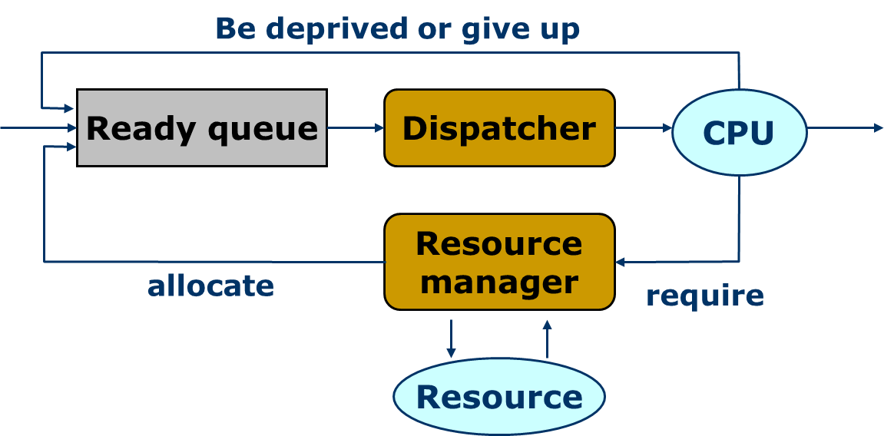
Review： How to schedule
The dispatcher gives control of the CPU to the process selected by the short-term scheduler.
Max CPU utilization
Max throughput
Min turnaround time
Min waiting time
Min response time
Notes:
每当CPU变为空闲时，操作系统就必须从就绪队列中选择一个进程来执行。进程选择由短期调度程序执行。调度程序从内存中就绪可执行的进程里选择一个，并为其中之一分配CPU。
短期调度频繁地为CPU选择新进程，通常每100ms至少执行一次。由于每次执行之间的时间较短，短期调度程序必须要快。如果需要10ms来确定执行一个运行100ms的进程，那么10/(100+10)=9%的CPU时间会仅仅用于（或浪费在）调度工作上。
分派程序是一个模块，用来将CPU的控制交给由短期调度程序所选择的进程，其功能包括：
切换上下文
切换到用户模式
跳转到用户程序的合适位置以重新启动这个程序
分派延迟：停止一个进程而启动另一个进程执行所要花费的时间

Slide 3
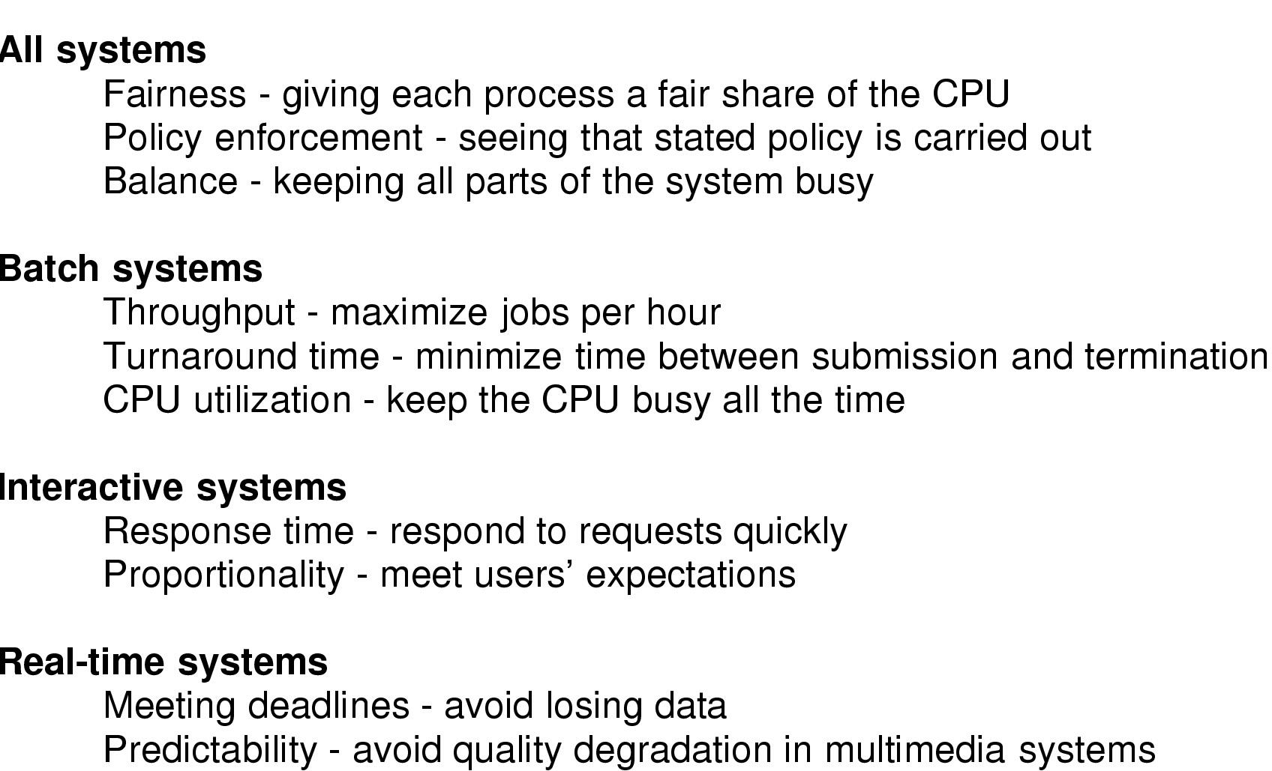
Review： Scheduling algorithms in Batch systems
Algorithms only suitable in batch systems are:
  First-Come, First-Served (FCFS)
  Shortest Job First (SJF)
  Shortest Remaining Time First
  Three-Level Scheduling
Notes:
每当CPU变为空闲时，操作系统就必须从就绪队列中选择一个进程来执行。进程选择由短期调度程序执行。调度程序从内存中就绪可执行的进程里选择一个，并为其中之一分配CPU。
短期调度频繁地为CPU选择新进程，通常每100ms至少执行一次。由于每次执行之间的时间较短，短期调度程序必须要快。如果需要10ms来确定执行一个运行100ms的进程，那么10/(100+10)=9%的CPU时间会仅仅用于（或浪费在）调度工作上。
分派程序是一个模块，用来将CPU的控制交给由短期调度程序所选择的进程，其功能包括：
切换上下文
切换到用户模式
跳转到用户程序的合适位置以重新启动这个程序
分派延迟：停止一个进程而启动另一个进程执行所要花费的时间

Slide 4
Process Arrival Time Burst Time
P₁ 0.0 7
P₂ 2.0 4
P₃ 4.0 1
P₄ 5.0 4
The corresponding Gantt Chart for SJF scheduling is:
Example of SRTF
P₁
P₃
P₂
P₄
Average waiting time: 4
Average turnaround time: 7.5
0
7
8
12
16
The corresponding Gantt Chart for SRTF scheduling is:
P₁
P₂
P₃
P₂
P₄
P₁
Average waiting time: 3
Average turnaround time: 7
0
2
4
5
7
11
16

Slide 5
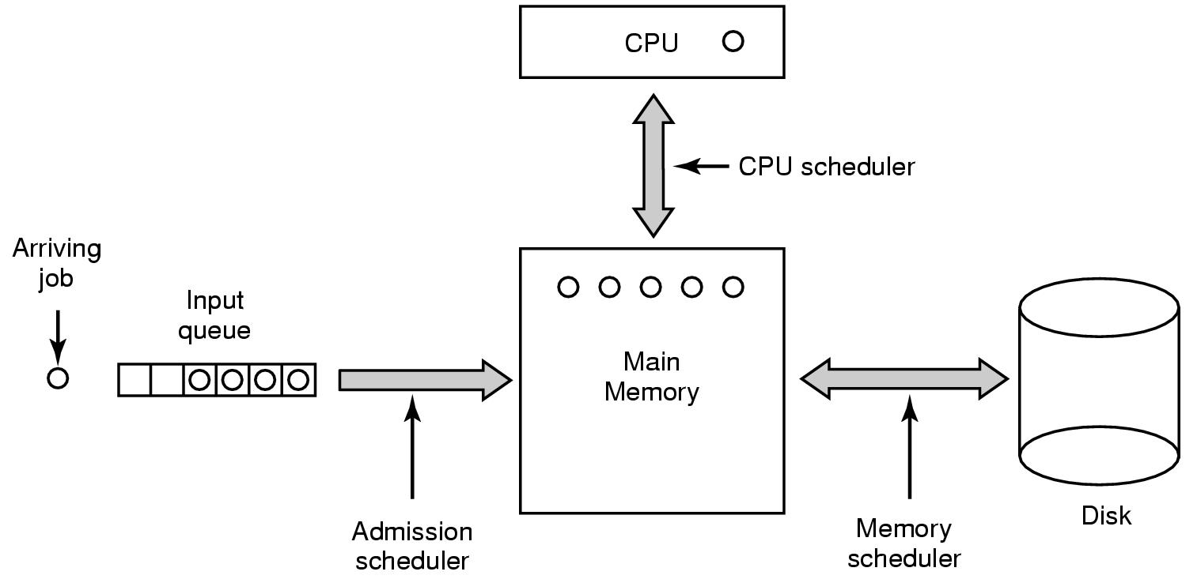
Three-Level Scheduling
3
1
2

Slide 6
Today’s topic
Scheduling algorithms for Interactive Systems
Scheduling algorithms for Real-time Systems
Evaluation

Slide 7
Scheduling in interactive systems
Some main algorithms that are suitable in both batch systems and interactive systems are:
  Priority Scheduling
  Round-Robin Scheduling (RR)
  Multilevel Queues Scheduling
  Multilevel Feedback Queues Scheduling

Slide 8
Priority Scheduling
In priority scheduling, the process whose priority is the highest will be chosen to run.
  Priorities are generally some fixed range of numbers. We use low numbers to represent high priority in our class.
  SJF is a special case, where the priority of a process is its predicted next CPU burst time.
Notes:
优先权调度算法：每个进程都有一个优先权与其关联，具有最高优先权的进程会被分配到CPU。具有相同优先权的进程按FCFS顺序调度。
SJF算法作为优先权算法，其优先权为下一个CPU区间的倒数。CPU区间越大，则优先权越小；反之亦然。
优先权调度可以使可抢占的或者非抢占的。当一个进程到达就绪队列时，其优先权与当前运行进程的优先权相比较。如果新到达进程的优先权高于当前运行进程的优先权，那么抢占优先权调度算法会抢占CPU。非抢占优先权调度算法只是将新进程加到就绪队列的头部。

Slide 9
Example of Priority Scheduling
Process Burst Time Priority
P₁ 10 3
P₂ 1 1
P₃ 2 4
P₄ 1 5
P₅ 5 2
Suppose the processes have arrived at time 0 in the order P₁, P₂, P₃, P₄, P₅
The Gantt chart is:
P₂
P₅
P₁
P₃
P₄
0
1
6
16
18
19
Average waiting time: 8.2

Slide 10
Problem of Priority Scheduling
Priority scheduling can be either preemptive or nonpreemptive.
  In preemptive ones, the newly arrived process with higher priority can preempt the CPU,
  However, in nonpreemptive ones, such process will be just put at the head of the ready queue.
A major problem is indefinite blocking (or starvation), i.e. low priority processes may never execute.
  one solution is aging, i.e. decreasing the priority of currently running process at each clock tick.
Notes:
优先权可通过内部或外部方式来定义。
内部优先权使用一些可测量数据以计算进程优先权，如时间极限、内存要求、打开文件的数量和平均I/O时间区间和平均CPU时间区间之比等。
外部优先权是通过操作系统之外的准则来设置的，如进程重要性、用于支付使用计算机的费用类型和数量、赞助工作的单位等。
优先权调度算法的一个主要问题是无穷阻塞（或饥饿），使某个低优先权进程无穷等待CPU在一个重负载计算机系统中，平稳的高优先权进程可以阻止低优先权进程获得CPU。
解决方案：老化，即以逐渐增加在系统中等待很长时间的进程的优先权的技术。

Slide 11
Round Robin scheduling (RR)
To prevent the starvation of low priority processes, another solution is:
  Assigning a maximum time quantum to each process, and the next process is allowed to run when the time quantum of current process is used up.
This strategy is called Round Robin, i.e. RR, which is an oldest, simplest, fairest, and most widely used algorithm.
Notes:
轮转法调度算法是专门为分时系统而设计的。它类似于FCFS调度，但是增加了抢占以在进程间切换。定义一个较小时间单元，称为时间量或时间片，通常为10ms到100ms。就绪队列作为循环队列处理。CPU调度程序循环就绪队列，为每个进程分配不超过一个时间片间隔的CPU。

Slide 12
Length of the quantum
Case 1: CPU burst <= one time quantum
  The process itself will release the CPU voluntarily.
  The scheduler will then proceed to the next process in the ready queue.
Case 2: CPU burst > one time quantum
  The timer will go off and will cause an interrupt to the OS.
  Execute a context switch, and the process will be put at the tail of the ready queue.
  The CPU scheduler will then select the next process in the ready queue.
Notes:
此后，可能存在两种情况：
进程可能只需要小于一个时间片的CPU区间。此时，进程本身会自动释放CPU。调度程序接着会处理就绪队列的下一个进程。
当前运行进程的CPU区间比一个时间片要长，定时器会中断并产生操作系统中断。进行上下文切换，该进程会被加入到就绪队列的尾部。
接着，CPU调度程序会选择就绪队列中的下一个进程

Slide 13
Example of RR with Time Quantum = 4
Process Burst Time
P₁ 24
P₂ 3
P₃ 3
The Gantt chart is:
Average waiting time is (6 + 4 + 7)/3=5.66
Typically, higher average turnaround than SJF, but better response.
P₁
P₂
P₃
P₁
P₁
P₁
P₁
P₁
0
4
7
10
14
18
22
26
30
Notes:
RR调度算法中，队列中没有进程被分配超过一个时间片的CPU时间。如果进程的CPU区间超过了一个时间片，那么该进程被抢占，而被放回到就绪队列。RR算法是可抢占的。

Slide 14
Performance evaluation of RR
If there are n processes in the ready queue and the time quantum is q, then
  each process gets 1/n of the CPU time in chunks of at most q time units at once.
  No process waits more than (n-1)q time units.
Performance
  q large ⇒
  q small ⇒
FCFS
  q must be large with respect to context switch, otherwise overhead is too high.
Notes:
如果就绪队列中有n个进程且时间片为q，那么每个进程会得到1/n的CPU时间，每个长度不超过q时间单元。每个进程必须等待CPU的时间不会超过(n-1)q各时间单元，直到它的下一个时间片为止。
RR算法的性能很大程度上依赖于时间片的大小。在极端情况下，如果时间片非常大（无限），那么RR策略与FCFS策略一样。如果时间片很小，那么RR方法称为处理机共享，（从理论上来说）n各进程对于用户来说都有它自己的处理器，速度各为真正处理器速度的1/n。

Slide 15


Performance evaluation of RR
Turnaround time varies with the time quantum
A smaller time quantum increased context switches
Notes:
上下文切换对RR的影响：假设只有一个具有10个时间单元的进程。如果时间片为12个时间单元，那么进程在不到一个时间片内就能完成，且没有额外开销。而如果时间片为6个时间单元，那么进程需要两个时间片，并产生了一次上下文切换。如果时间片为1个单元，那么就有9个上下文切换，相应地使进程执行减慢。
因此，希望时间片要比上下文切换时间长。如果上下文切换时间约为时间片的10%，那么约10%的CPU时间会浪费在上下文切换上。
周转时间也依赖于时间片的大小。

Slide 16
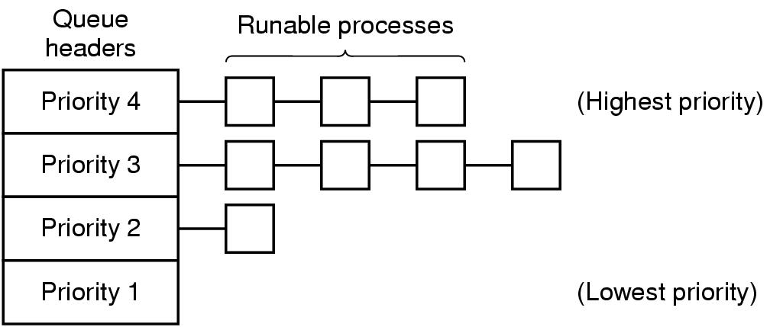
Multilevel Queue scheduling
If processes can be easily classified into different groups, the ready queue is able to be partitioned into separate queues and each has its own scheduling algorithms.
RR
1
2
3
FCFS
4
Notes:
多级队列调度将就绪队列分成多个独立队列。根据进程的某些属性，如内存大小、进程优先权或进程类型，进程会被永久地分配到一个队列。每个队列有自己的调度算法。
例如，可以方便地将一组进程按优先级分成若干类，并且在各类之间采用优先级调度，而在各类进程的内部采用轮转调度。

Slide 17
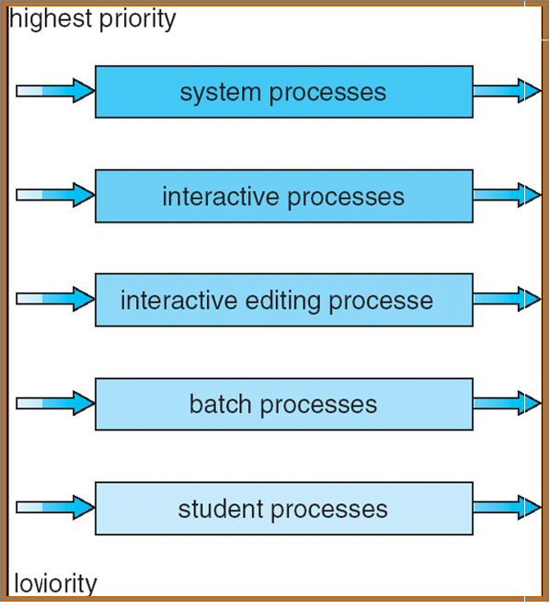
Example of multilevel queue
Highest priority
Scheduling among queues, there are two strategies:
  Fixed priority scheduling => Possibility of starvation.
  Time slice – each queue gets a certain amount of CPU time which it can schedule amongst its processes; i.e.:
    80% to foreground in RR
    20% to background in FCFS
Lowest priority
Notes:
多级队列调度将就绪队列分成多个独立队列。根据进程的某些属性，如内存大小、进程优先权或进程类型，进程会被永久地分配到一个队列。每个队列有自己的调度算法。
队列之间必须有调度，通常采用固定优先权可抢占调度来实现。
每个队列与更低优先权队列相比有绝对的优先权。
另一种可能是在队列之间划分时间片。每个队列都有一定的CPU时间，这可用于调度队列内的不同进程。

Slide 18
Multilevel Feedback Queue
Processes in multilevel queue scheduling are permanently in a certain queue, whose disadvantage is inflexible.
To allow a process to move among queues, multilevel feedback queue scheduling comes up. Its basic idea is:
  If a process uses too much CPU time, it will be moved to a lower-priority queue.
  A process that waits too long in a lower-priority queue may be moved to a higher-priority queue.
Notes:
多级队列调度算法中进程并不在队列之间移动，优点是低调度开销，缺点是不够灵活。
多级反馈队列调度允许进程在队列之间移动。其主要思想是根据不同CPU区间特点以区分进程。如果进程使用过多CPU时间，那么它会被移到更低优先权队列。这种方案会将I/O约束和交互式进程留在较高优先权队列。类似地，在较低优先权队列中等待过长的进程会被转移到较高优先权队列。这种形式的老化能阻止饥饿的发生。

Slide 19

Example of Multilevel Feedback Queue
Three queues:
  Q₀ – time quantum 8 ms
  Q₁ – time quantum 16 ms
  Q₂ – FCFS
Scheduling
  A new job enters queue Q₀ which is served FCFS. When it gains CPU, job receives 8 milliseconds.
  If it does not finish in 8 milliseconds, job is moved to queue Q₁.At Q₁ job is again served FCFS and receives 16 additional milliseconds.
  If it still does not complete, it is preempted and moved to queue Q₂.
Notes:
进入就绪队列的进程被放在队列0内。队列0的每个进程都有8ms的时间片。如果一个进程必能在这一时间内完成，那么它就被移到队列1的尾部。如果队列0为空，队列1头部进程会得到一个16ms的时间片。如果它不能完成，那么它将被抢占，并被放到队列2中。只有当队列0和1为空时，队列2内的进程才可根据FCFS来运行。

Slide 20
Implementation of Multilevel Feedback Queue
Multilevel-feedback-queue scheduling defined by the following parameters:
  number of queues
  scheduling algorithms for each queue
  method used to determine when to upgrade a process
  method used to determine when to demote a process
  method used to determine which queue a process will enter when that process needs service
The most general scheme, but the most complex one!
Notes:
多级反馈队列调度程序可由下列参数来定义：
队列数量
每个队列的调度算法
用以确定进程何时升级到较高优先权队列的方法
用以确定进程何是降级到较低优先权队列的方法
用以确定进程在需要服务时应进入哪个队列的方法
多级反馈队列是最通用的方案，但是它也是最复杂的。

Slide 21
Today’s topic
Scheduling algorithms for Interactive Systems
Scheduling algorithms for Real-time Systems
Evaluation

Slide 22
Real-Time CPU Scheduling
Can present obvious challenges
Soft real-time systems – Critical real-time tasks have the highest priority, but no guarantee as to when tasks will be scheduled
Hard real-time systems – task must be serviced by its deadline

Slide 23
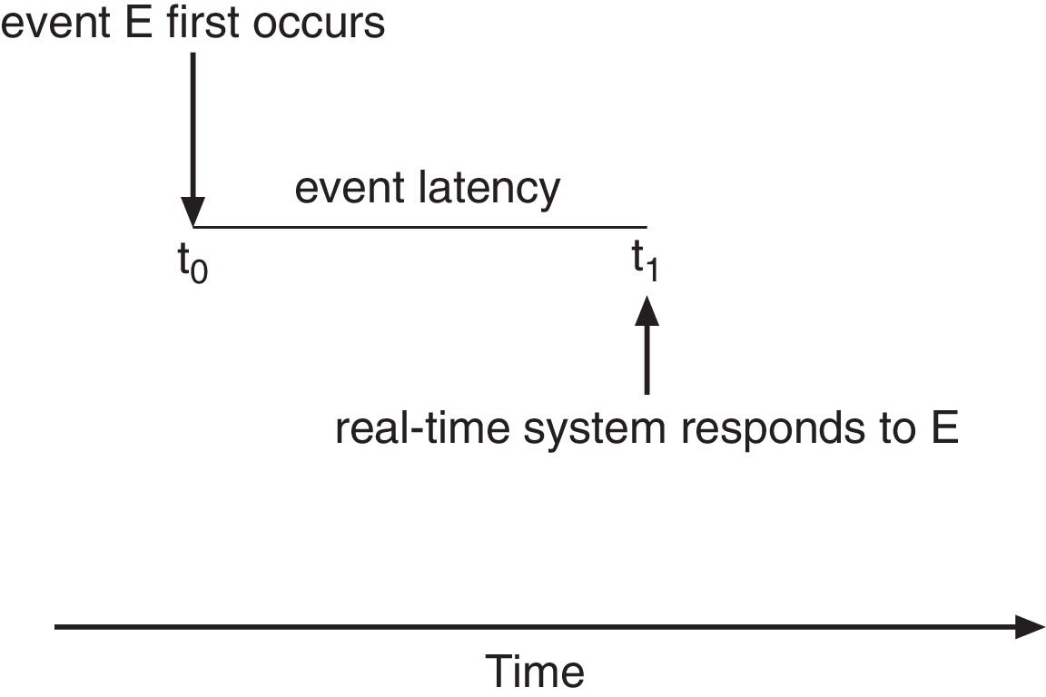
Real-Time CPU Scheduling
Event latency – the amount of time that elapses from when an event occurs to when it is serviced.
Two types of latencies affect performance
  Interrupt latency – time from arrival of interrupt to start of routine that services interrupt
  Dispatch latency – time for schedule to take current process off CPU and switch to another

Slide 24
Priority-based Scheduling
For real-time scheduling, scheduler must support preemptive, priority-based scheduling
  But only guarantees soft real-time
For hard real-time must also provide ability to meet deadlines
Processes have new characteristics: periodic ones require CPU at constant intervals
  Has processing time t, deadline d, period p
  0 ≤ t ≤ d ≤ p
  Rate of periodic task is 1/p

Slide 25
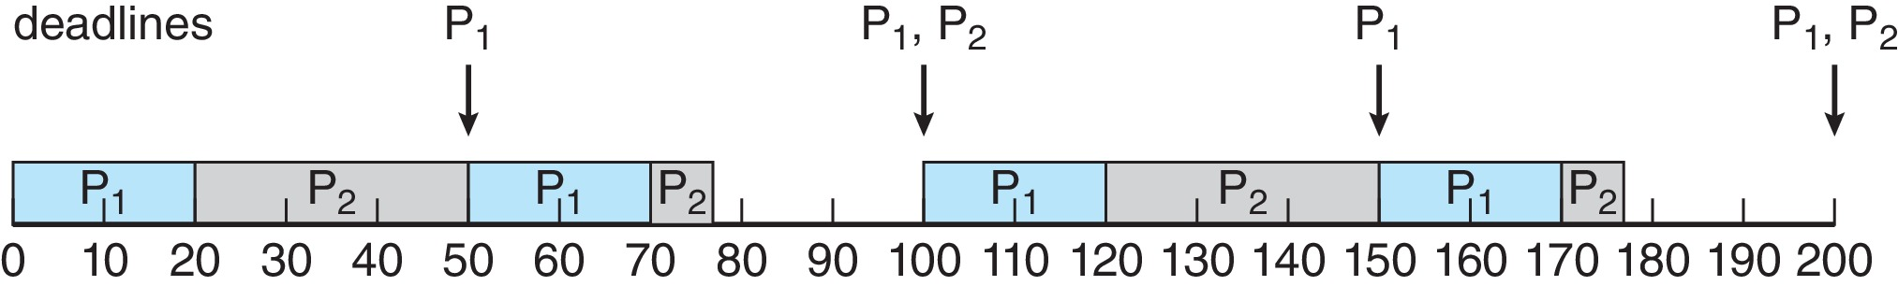
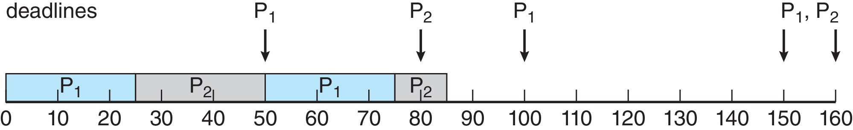
Rate Montonic Scheduling
A priority is assigned based on the inverse of its period
Shorter periods = higher priority;
Longer periods = lower priority;
P₁ is assigned a higher priority than P₂.
Process P2 misses finishing its deadline at time 80

Slide 26
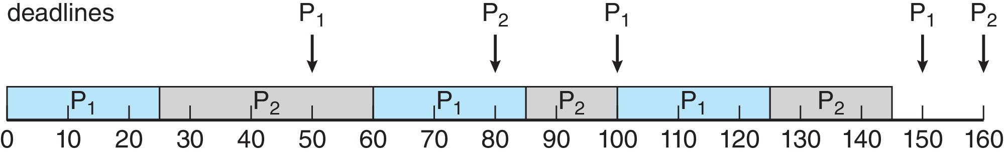
Earliest Deadline First Scheduling (EDF)
Priorities are assigned according to deadlines:
  the earlier the deadline, the higher the priority;
  the later the deadline, the lower the priority

Slide 27
Proportional Share Scheduling
T shares are allocated among all processes in the system
An application receives N shares where N < T
This ensures each application will receive N / T of the total processor time

Slide 28
Today’s topic
Scheduling algorithms for Interactive Systems
Scheduling algorithms for Real-time Systems
Evaluation

Slide 29

Algorithm Evaluation
How to select CPU-scheduling algorithm for an OS?
Determine criteria, then evaluate algorithms
Deterministic modeling
  Type of analytic evaluation
  Takes a particular predetermined workload and defines the performance of each algorithm for that workload
Consider 5 processes arriving at time 0:

Slide 30



Deterministic Evaluation
For each algorithm, calculate minimum average waiting time
Simple and fast, but requires exact numbers for input, applies only to those inputs
  FCS is 28ms:
  Non-preemptive SFJ is 13ms:
  RR is 23ms:

Slide 31
Queueing Models
Describes the arrival of processes, and CPU and I/O bursts probabilistically
  Commonly exponential, and described by mean
  Computes average throughput, utilization, waiting time, etc
Computer system described as network of servers, each with queue of waiting processes
  Knowing arrival rates and service rates
  Computes utilization, average queue length, average wait time, etc

Slide 32
Little’s Formula
n = average queue length
W = average waiting time in queue
λ = average arrival rate into queue
Little’s law – in steady state, processes leaving queue must equal processes arriving, thus:
n = λ x W
  Valid for any scheduling algorithm and arrival distribution
For example, if on average 7 processes arrive per second, and normally 14 processes in queue, then average wait time per process = 2 seconds

Slide 33
Simulations
Queueing models limited
Simulations more accurate
  Programmed model of computer system
  Clock is a variable
  Gather statistics indicating algorithm performance
  Data to drive simulation gathered via
    Random number generator according to probabilities
    Distributions defined mathematically or empirically
    Trace tapes record sequences of real events in real systems

Slide 34
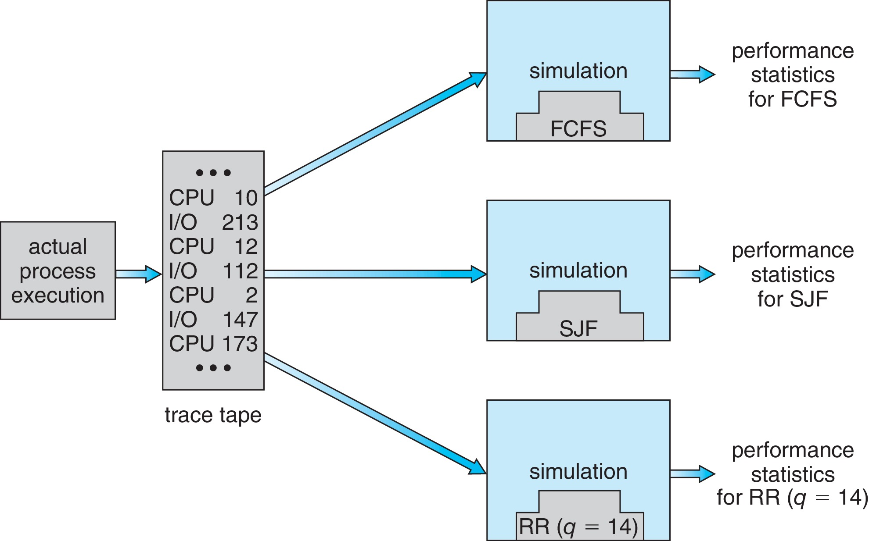
Evaluation of CPU Schedulers by Simulation

Slide 35
Implementation
Even simulations have limited accuracy
Just implement new scheduler and test in real systems
  High cost, high risk
  Environments vary
Most flexible schedulers can be modified per-site or per-system
Or APIs to modify priorities
But again environments vary

Slide 36
Homework
Consider the following set of processes, with the length of the CPU-burst time given in milliseconds:
process burst time priority arrive
P₁ 10 3 0
P₂ 1 1 1
P₃ 2 3 2
P₄ 1 4 3
P₅ 5 2 4
a. Draw four Gantt charts illustrating the execution of these processes using FCFS, preemptive SJF, a preemptive priority (smaller priority implies higher priority), and RR (quantum=2) scheduling
b. What is the turnaround time of each process for each of the scheduling algorithms in part a
c. What is the waiting time of each process for each of the scheduling algorithms in part a
d. Which of the schedules in part a results in the minimal average waiting time (over all processes)

Slide 37
Summary
Describe various CPU scheduling algorithms
Assess CPU scheduling algorithms based on scheduling criteria
Explain the issues related to multiprocessor and multicore scheduling
Describe various real-time scheduling algorithms
Describe the scheduling algorithms used in the Windows, Linux, and Solaris operating systems
Apply modeling and simulations to evaluate CPU scheduling algorithms

Slide 38
End of CPU Scheduling -
Scheduling algorithms for Interactive Systems

Slide 39
Multiple-Processor Scheduling
CPU scheduling more complex when multiple CPUs are available
Multiprocessor may be any one of the following architectures:
  Multicore CPUs
  Multithreaded cores
  NUMA systems
  Heterogeneous multiprocessing

Slide 40
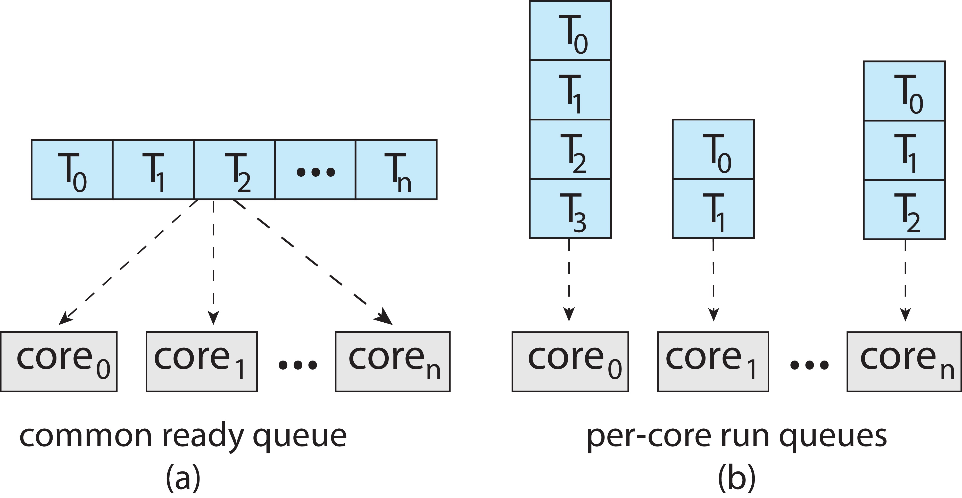
Multiple-Processor Scheduling
Symmetric multiprocessing (SMP) is where each processor is self scheduling.
All threads may be in a common ready queue (a)
Each processor may have its own private queue of threads (b)

Slide 41
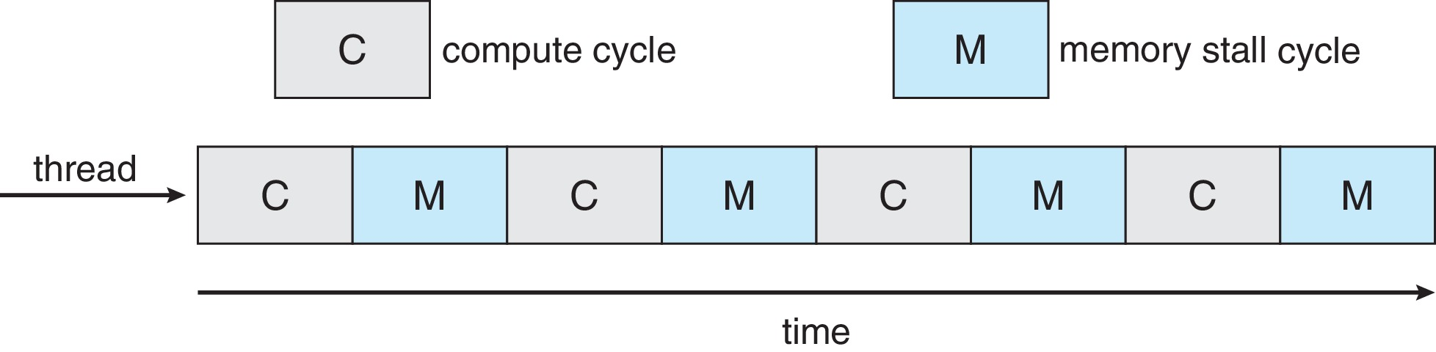
Multicore Processors
Recent trend to place multiple processor cores on same physical chip
Faster and consumes less power
Multiple threads per core also growing
  Takes advantage of memory stall to make progress on another thread while memory retrieve happens

Slide 42
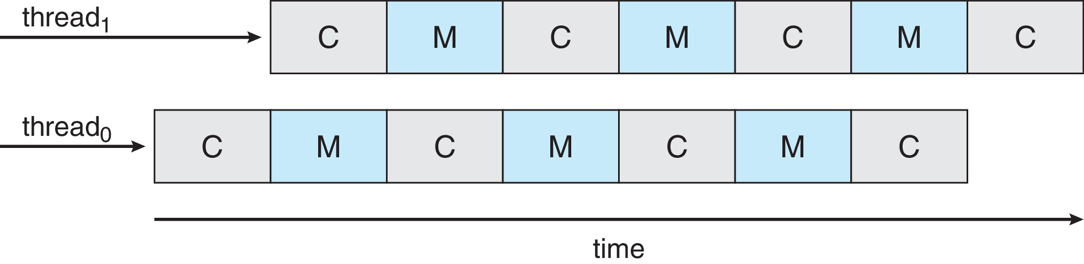
Multithreaded Multicore System
Each core has > 1 hardware threads.
If one thread has a memory stall, switch to another thread!

Slide 43
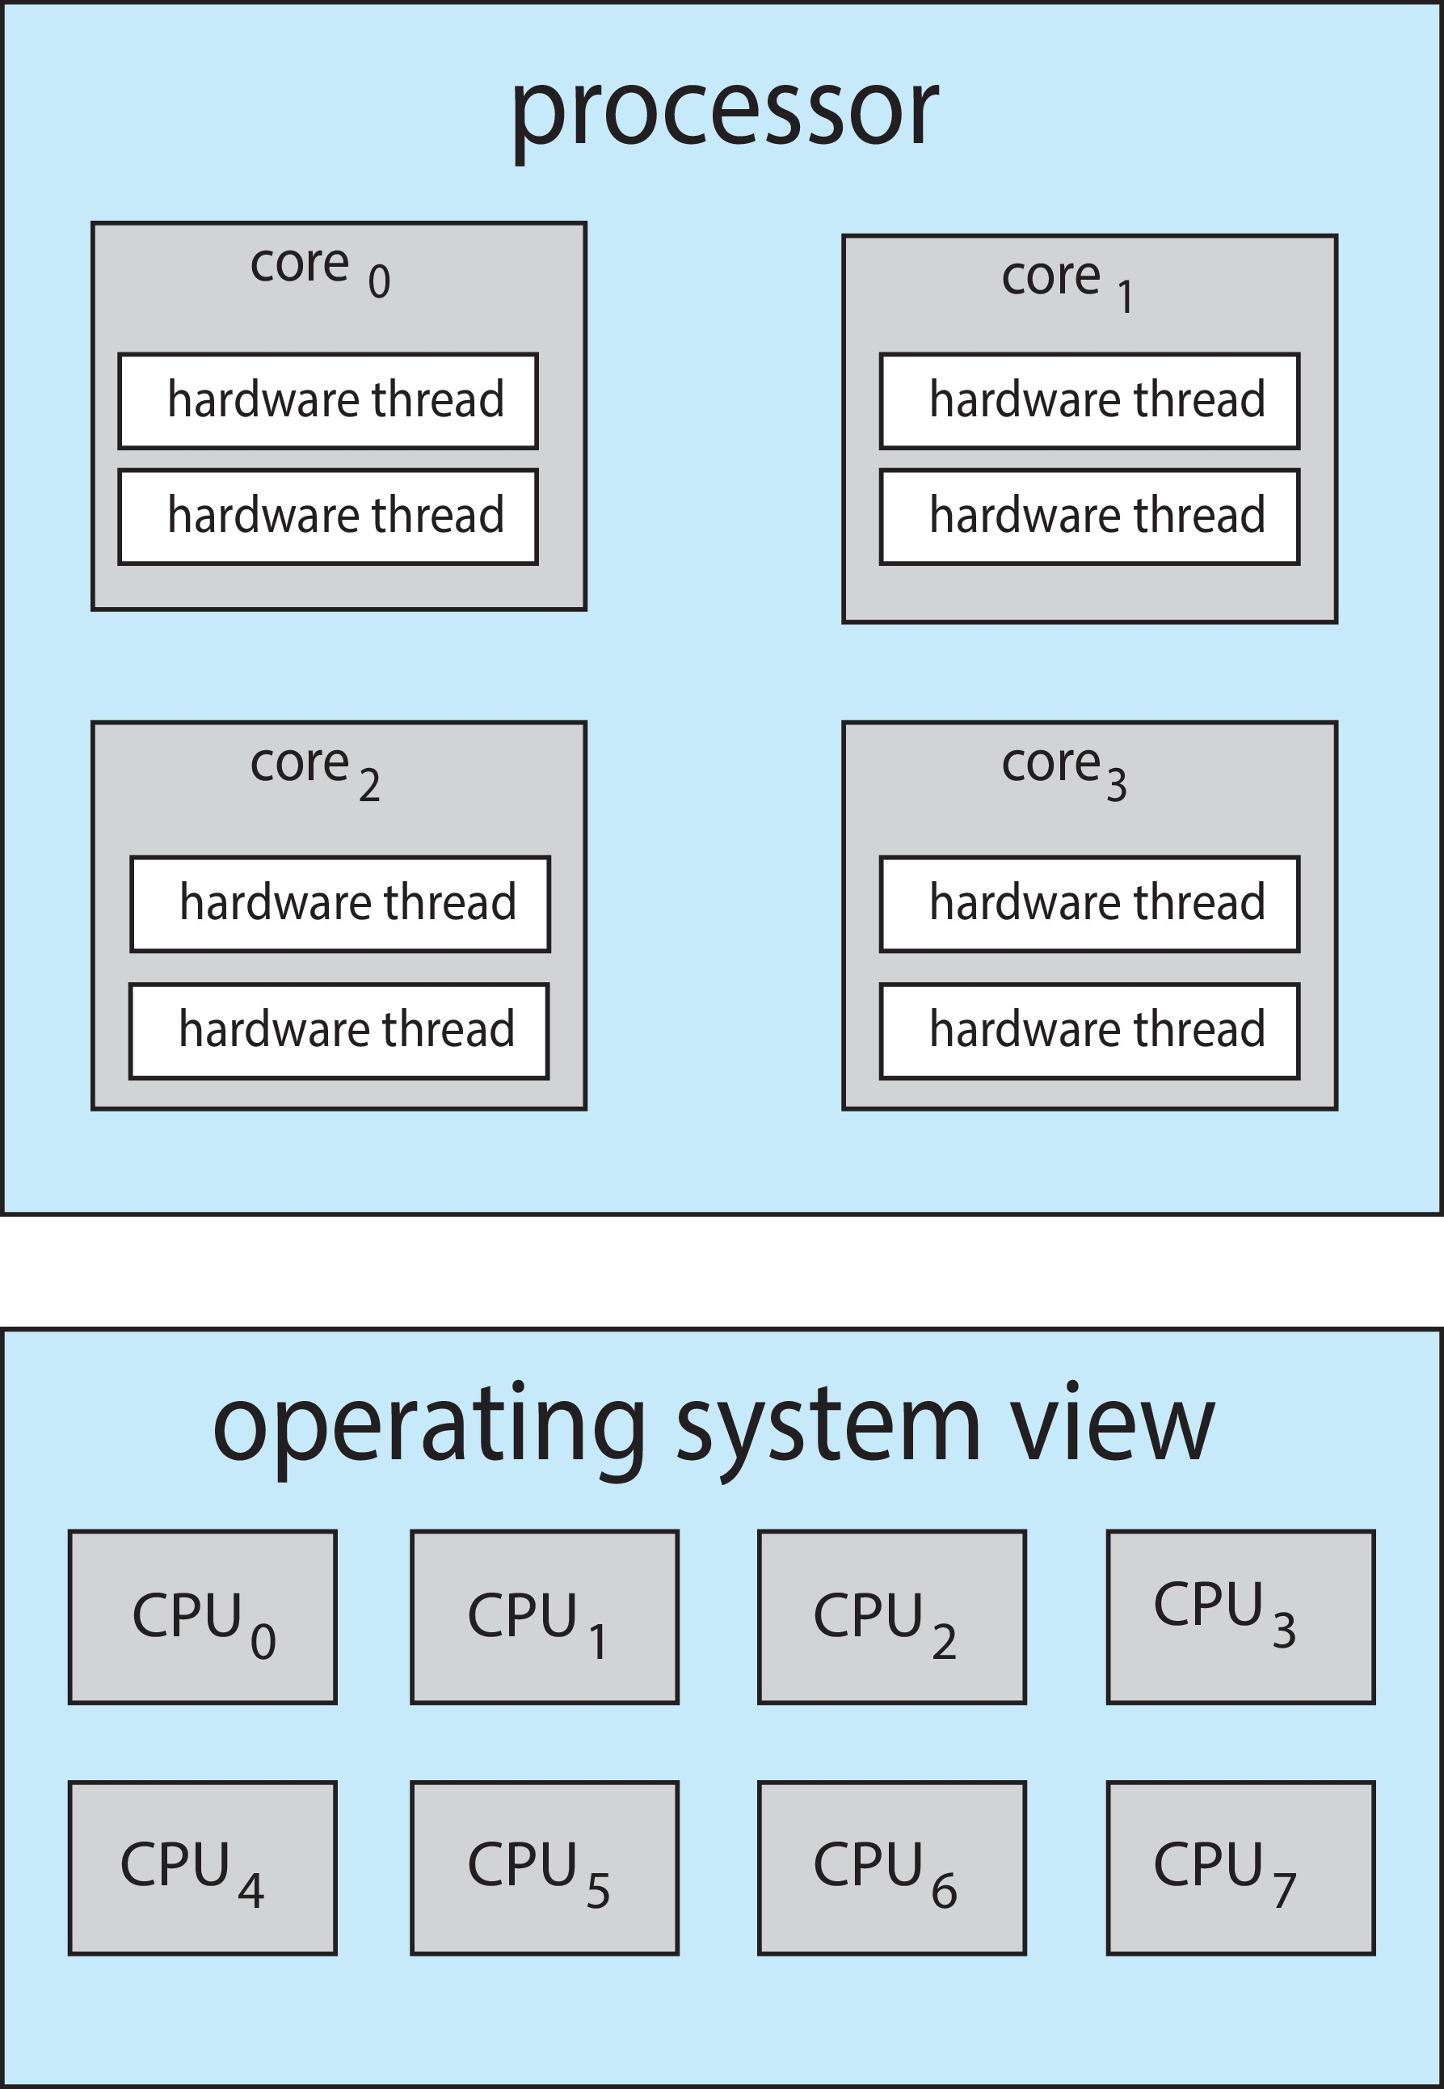
Multithreaded Multicore System
Chip-multithreading (CMT) assigns each core multiple hardware threads. (Intel refers to this as hyperthreading.)
On a quad-core system with 2 hardware threads per core, the operating system sees 8 logical processors.

Slide 44
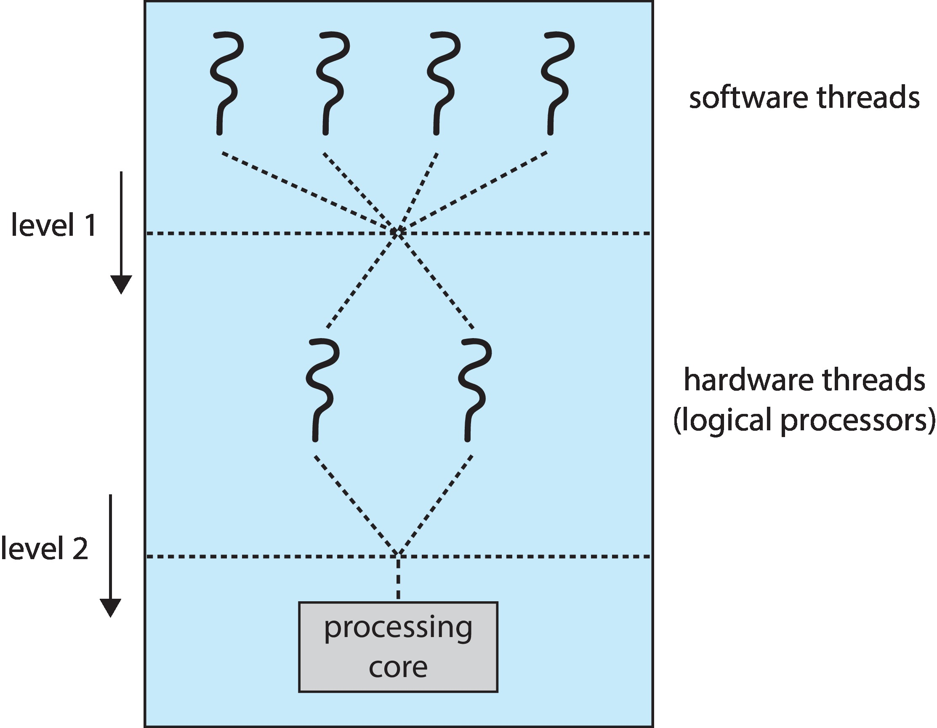
Multithreaded Multicore System
Two levels of scheduling:
The operating system deciding which software thread to run on a logical CPU
How each core decides which hardware thread to run on the physical core.

Slide 45
Multiple-Processor Scheduling – Load Balancing
If SMP, need to keep all CPUs loaded for efficiency
Load balancing attempts to keep workload evenly distributed
Push migration – periodic task checks load on each processor, and if found pushes task from overloaded CPU to other CPUs
Pull migration – idle processors pulls waiting task from busy processor

Slide 46
Multiple-Processor Scheduling – Processor Affinity
When a thread has been running on one processor, the cache contents of that processor stores the memory accesses by that thread.
We refer to this as a thread having affinity for a processor (i.e. “processor affinity”)
Load balancing may affect processor affinity as a thread may be moved from one processor to another to balance loads, yet that thread loses the contents of what it had in the cache of the processor it was moved off of.
Soft affinity – the operating system attempts to keep a thread running on the same processor, but no guarantees.
Hard affinity – allows a process to specify a set of processors it may run on.

Slide 47

NUMA and CPU Scheduling
If the operating system is NUMA-aware, it will assign
memory closes to the CPU the thread is running on.

